Slide 1
The liver
Dr. Mezjda Ismail Rashaan,consultant surgeon
University of Sulaymania
Faculty of medical sciences
School of medicine
Kurdistan

Slide 2
Anatomy and embryology of the liver:-
-foregut structure, endodermal bud(liver, gal bladder, extrahepatic ducts
-liver cells are bipotential develop(hepatocytes & intrahepatic bile ducts cells)
-liver endothelial cells arise from vitellian & umbilical vein, this form sinusides
-Glissons capsule
-ligaments include:
.rt & lt triangular lig.
.falciform lig. (from umbilicus to interlober fissure of liver)
.coronary lig.
.hepatoduodenal lig.
.gastrohepatic lig.

Slide 3
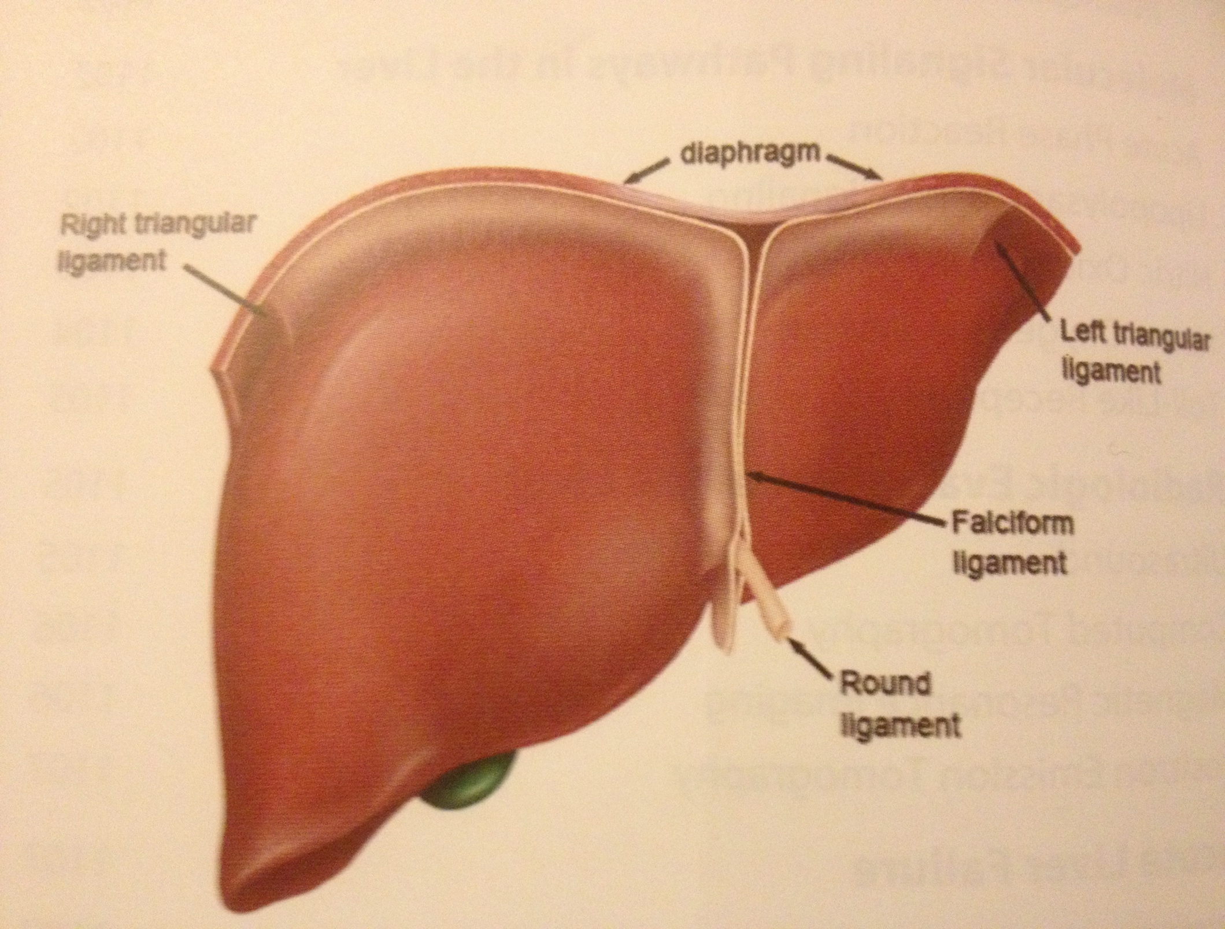
ligaments

Slide 4
Blood supply and neural innervations:-
-blood supply:
.75% portal vein
.25% hepatic artery from:
80% caeliac art.
20% SMA
.venous (rt., lt, middle hepatic vein to IVC)
-neural is via parasympathetic (vagus nerve)and sympathetic

Slide 5
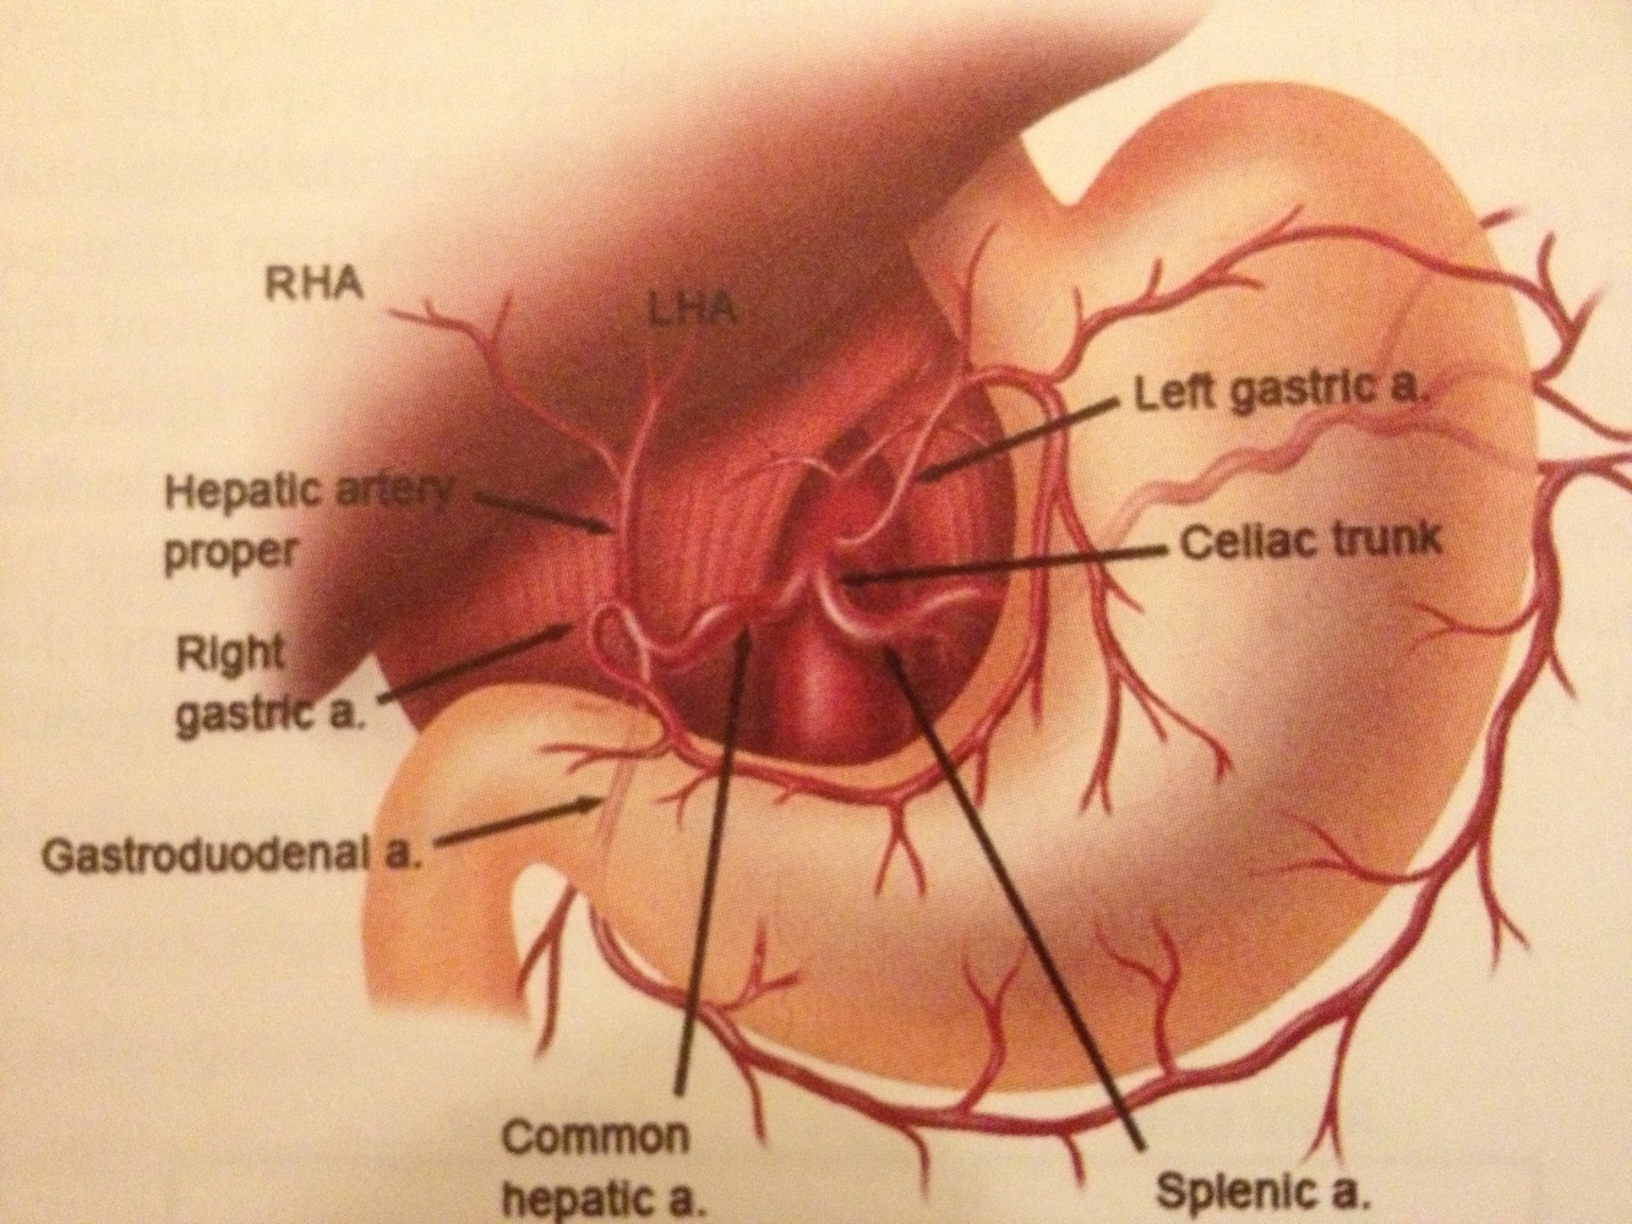
Blood supply

Slide 6
Lymphatics drainage:-
-peri-sinusidal space of Disse and peri-portal clefts of Mall to hilar cystic duct LNs and with common bile duct to caeliac area…

Slide 7
Internal structure:-
-8 segmental functional units:
.right include 5,6,7,8 segments
.left include 1,2,3,4 segments
-real functional unites are lobules
- Cantlies line separate rt & lt lobes

Slide 8
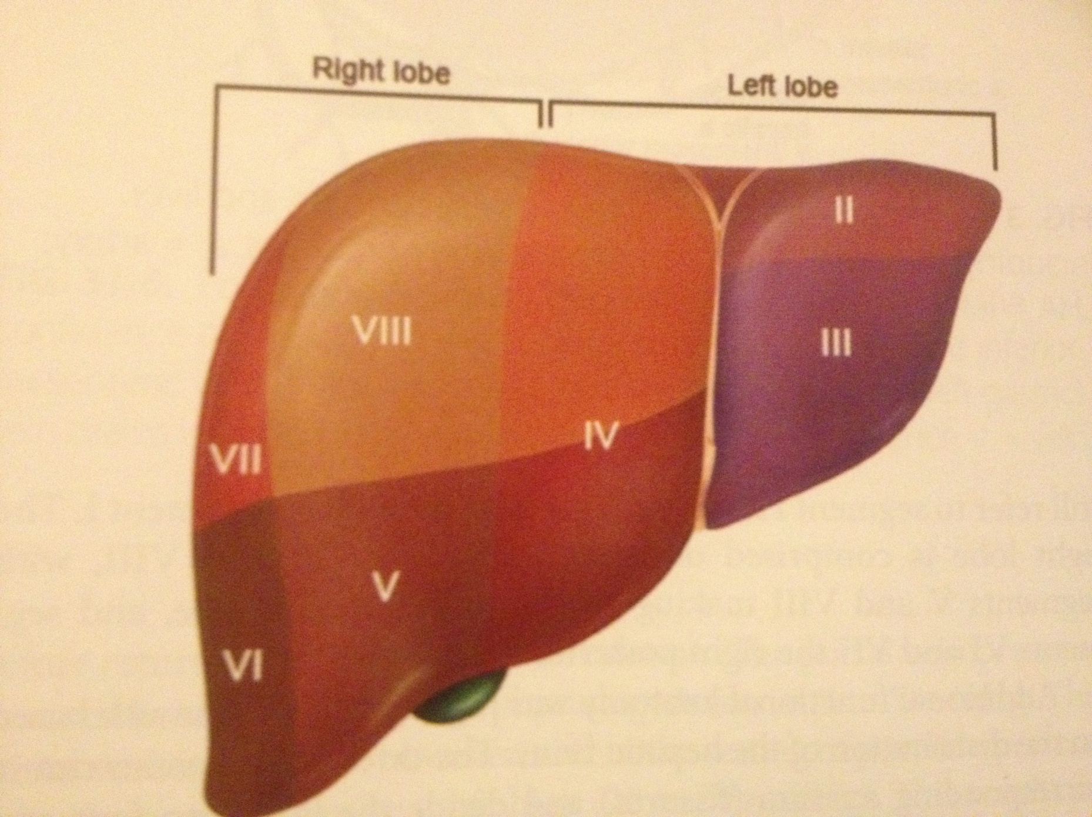
Liver segments

Slide 9
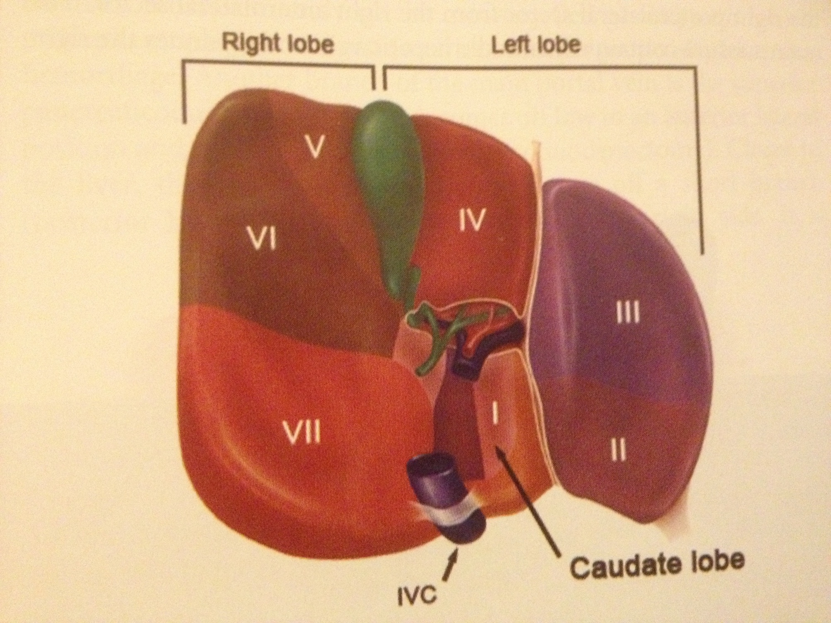

Slide 10
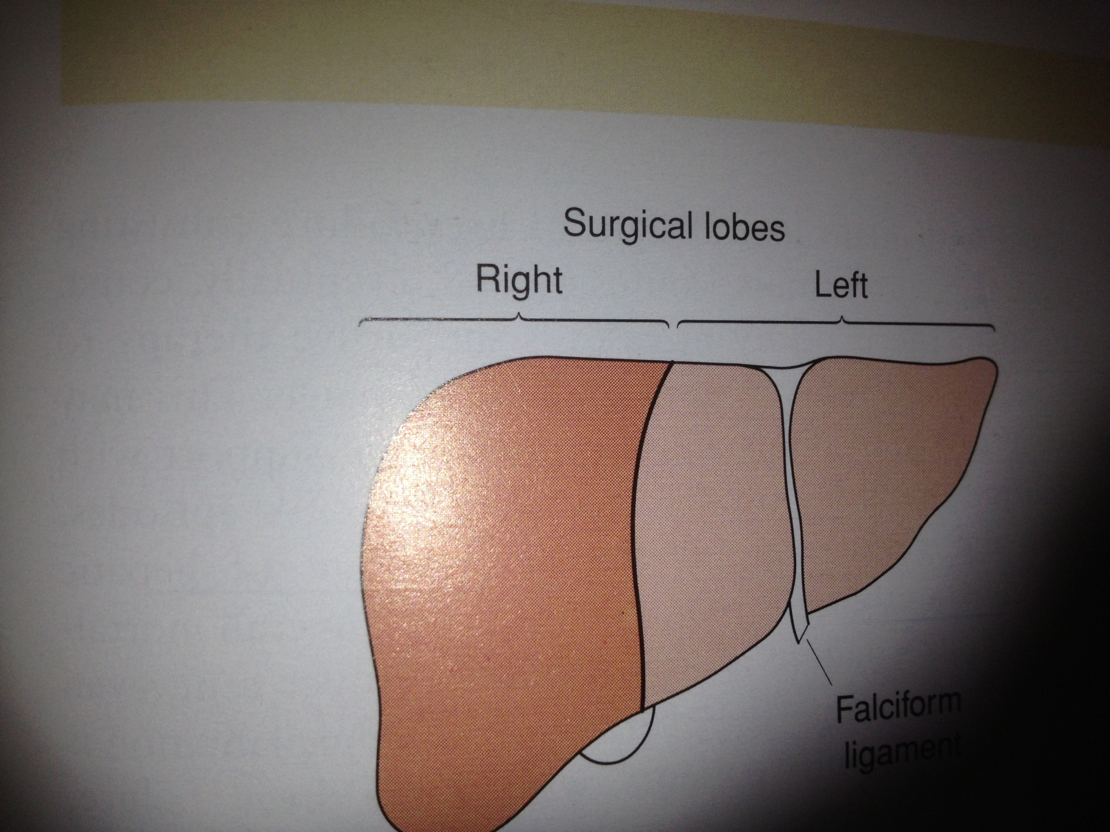

Slide 11
Functions of the liver:-
(storage, metabolism, production, secretion)
1-maintain core body temp.
-Ph balance and correction of the lactic acidosis
3-synthesis of clotting factors
4-glucose metabolism, glycolysis, glycogenesis
5-protein metabolism, urea formation
6-bilirubin formation
7-drugs and hormones metabolism
8-removal of gut endo-toxins & foreign bodies.. (reticuloendothelial system)

Slide 12
Investigations:-
1-LFT
.bilirubin ( pre-, post- & hepatic dis.)
.alk. phosphatase (obstructive jaundice, cholestatic liver)
.AST,ALT ( increase in acute hepatocellular dis. like viral hepatitis, alcoholic abuse, autoimmune dis., medications…)
.GGT (liver injury , acute alcohol ingestion)
.Albumin
.prothrombine time ( PT )

Slide 13
2- Imaging:-
A-Sonography
.liver tumor, bile duct dilatation, gal stones
.doppler sonography flow of HA, PV, HV
.guiding percutaneouse biopsy
.therapeutic as in abscess drainage by pig- tail catheter

Slide 14
Invest. Cont.
B- CT –Abdomen with or without contrast ( oral &
intravenouse contrast)
.lesions
.haemangiomas
.inflammatory ring enhancement
.density (solid or cystic lesions)

Slide 15
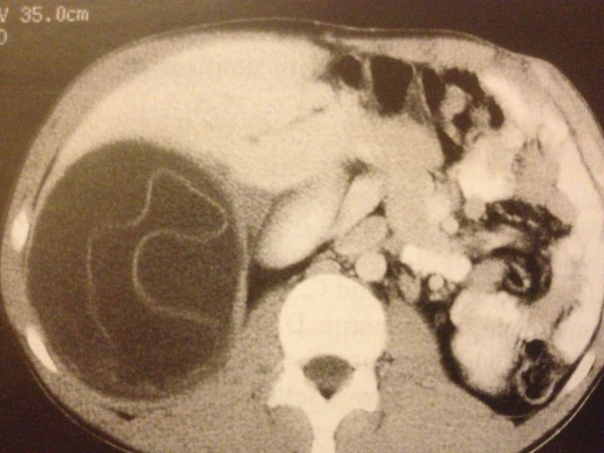
Ct-abdomen:-

Slide 16
Invest.cont:-
C-MRI
.no iodine
.non invasive
D-MRCP
E-MRA
.for chronic liver disease and coagulopathy PV thrombosis

Slide 17
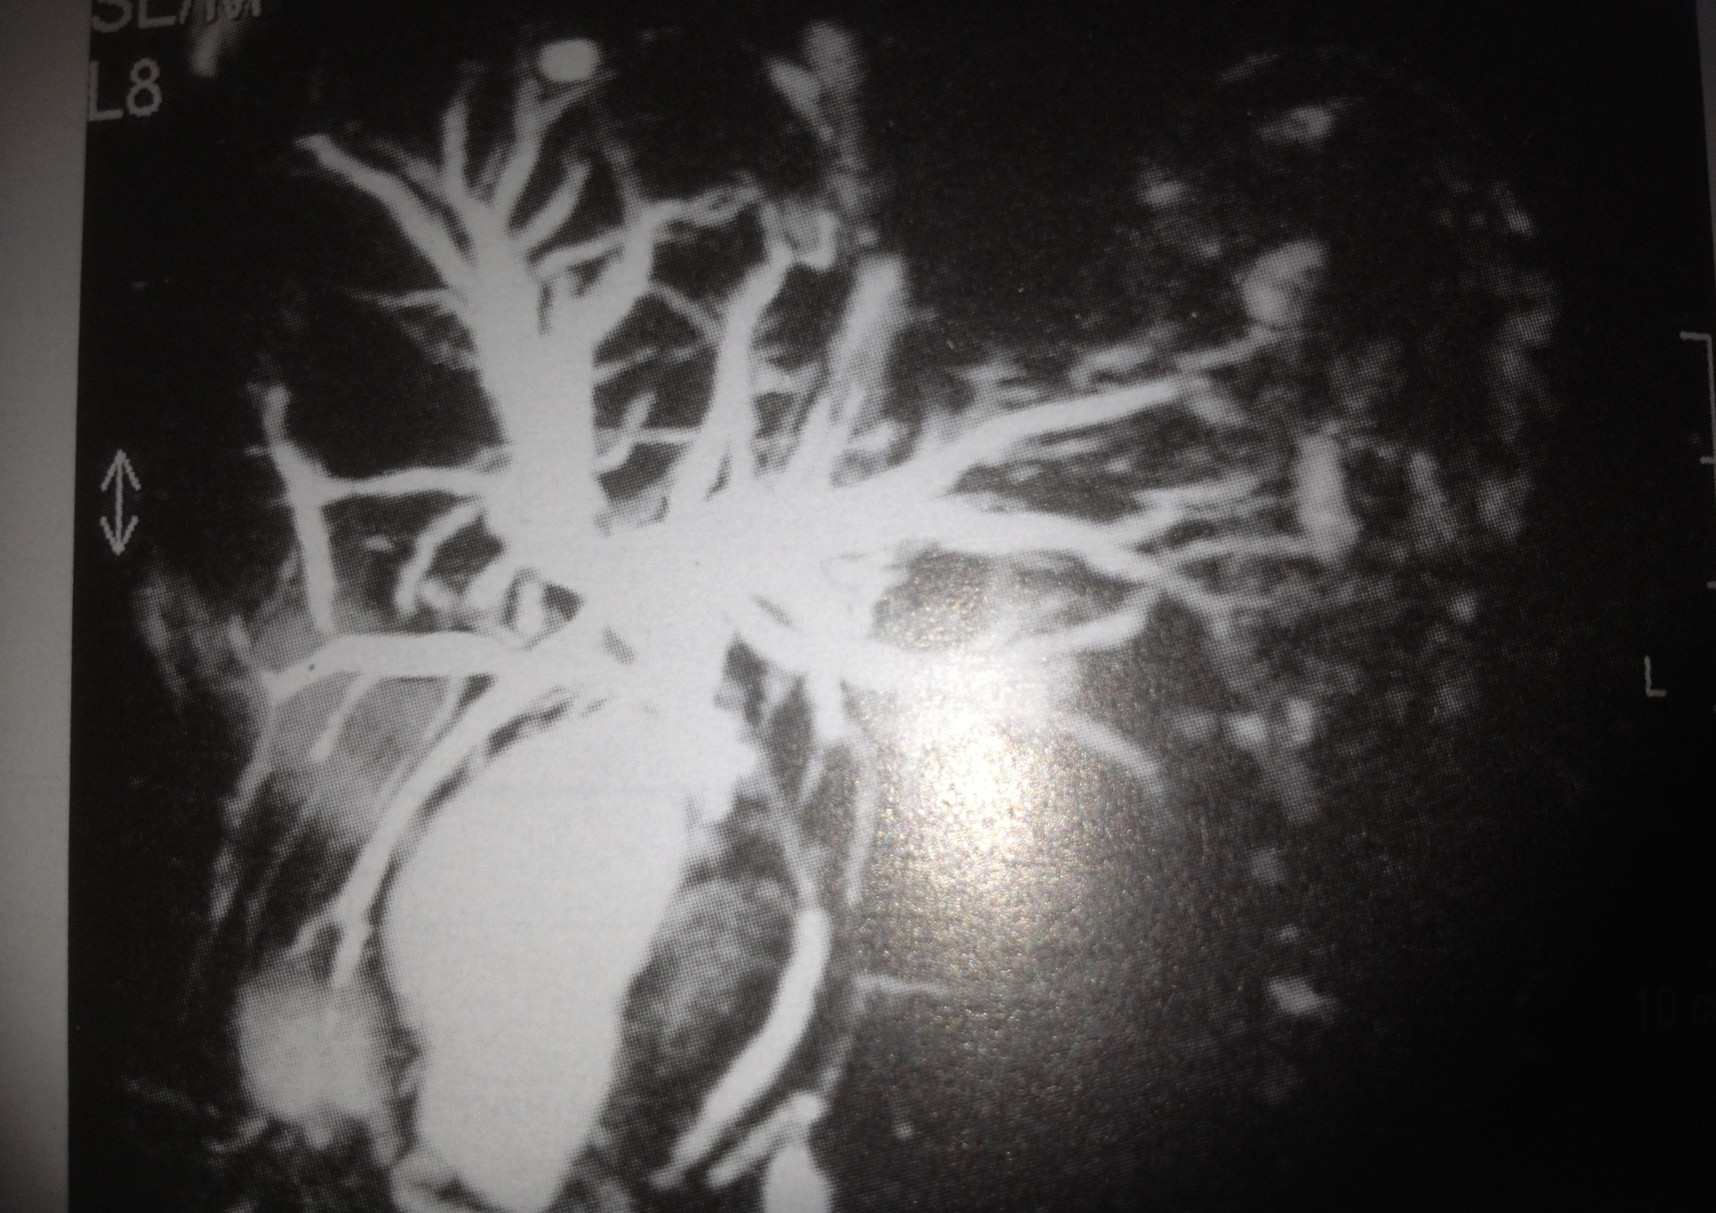
MRCP

Slide 18
Ivest.cont:-
E- ERCP
.in obstructive jaundice
.stone retrieval
.balloon dilatation of stricture
.endoprothese
.brush cytology
F-EUS
.hilar tumor extend

Slide 19
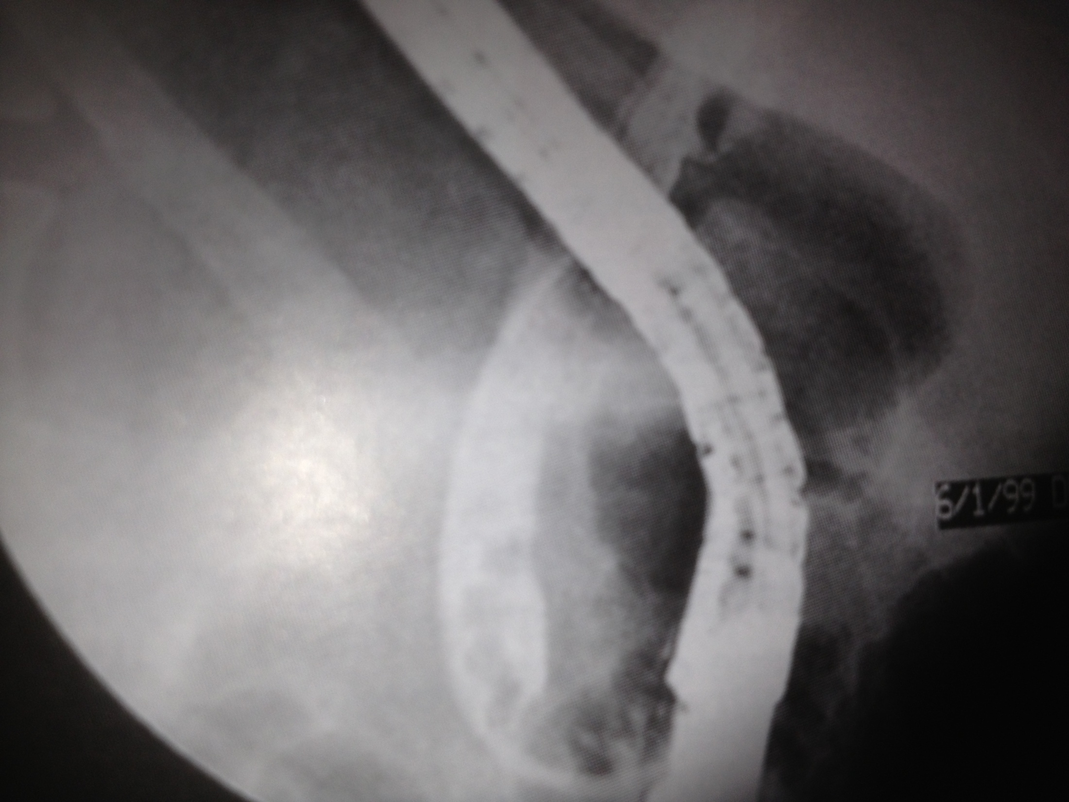

Slide 20
Invest. Cont:-
G-PTC
.if ERCP failed or impossible as in patient with previous polya gastrectomy, in hilar bile duct tumor

Slide 21
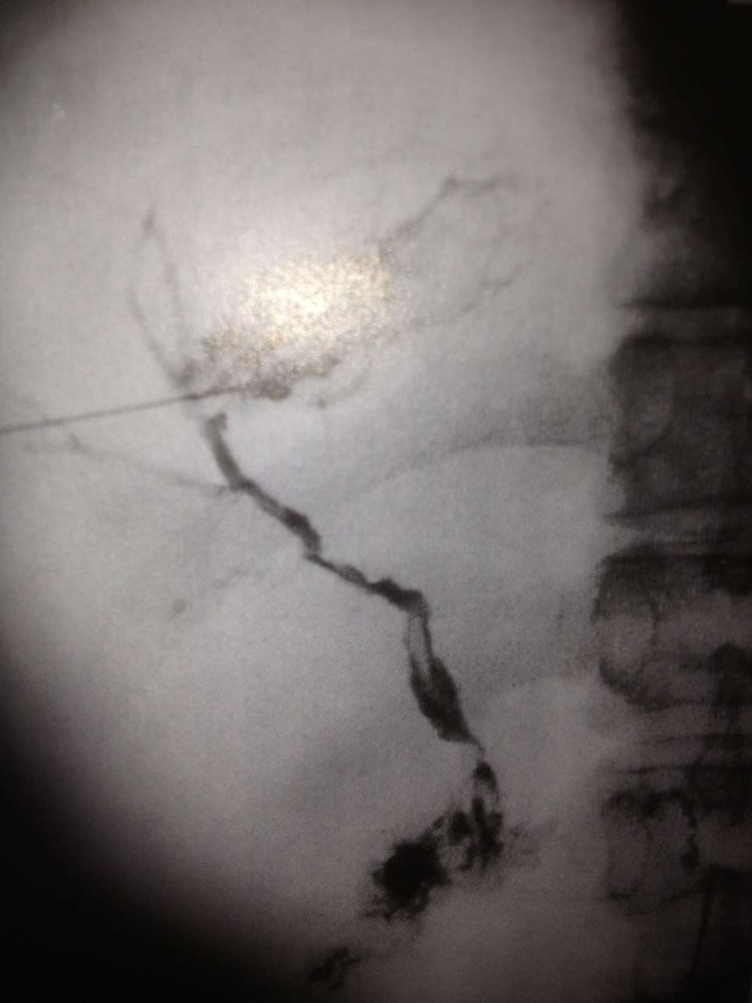
PTC

Slide 22
Invest. Cont:-
H-Angiography
.selective for diagnosis and therapeutic
.visualize rt, Lt. hepatic art.
.patency of portal vein
.nature of liver nodule as primary liver tumor has good
arterial blood supply
.therapeutic intervention as in :-
-embolisation of bleeding sites
-occlusion A-V malformation
-treatment of liver tumor ( chemoembolisation)

Slide 23
Invest. Cont:-
I-Nuclear medicine scanning with Iodoida is Te 99 labelled redionuclide specially in diagnosis of bile duct leak, biliary obstruction.
-Sulpher colloid liver screening for kupffer cells, in adenoma and haemangioma no kupffer cells so it is not enhanced

Slide 24
Invest. Cont:-
J-Laparascopic & Laparascopic US
.staging of hepatopancreaticobiliary cancer which not seen by other methods
. In 30% to diagnose peritoneal metas. and superficial liver tumors
. With US increase this % by showing also the relation of the tumor to the bile ducts art.

Slide 25
Invest.cont:-
K-Flurodeoxyglucose-positron emission tomography
( FDH-PET)
. Depend on glucose intake by cancer cells in comparison with adenoma, liver inflammation.

Slide 26
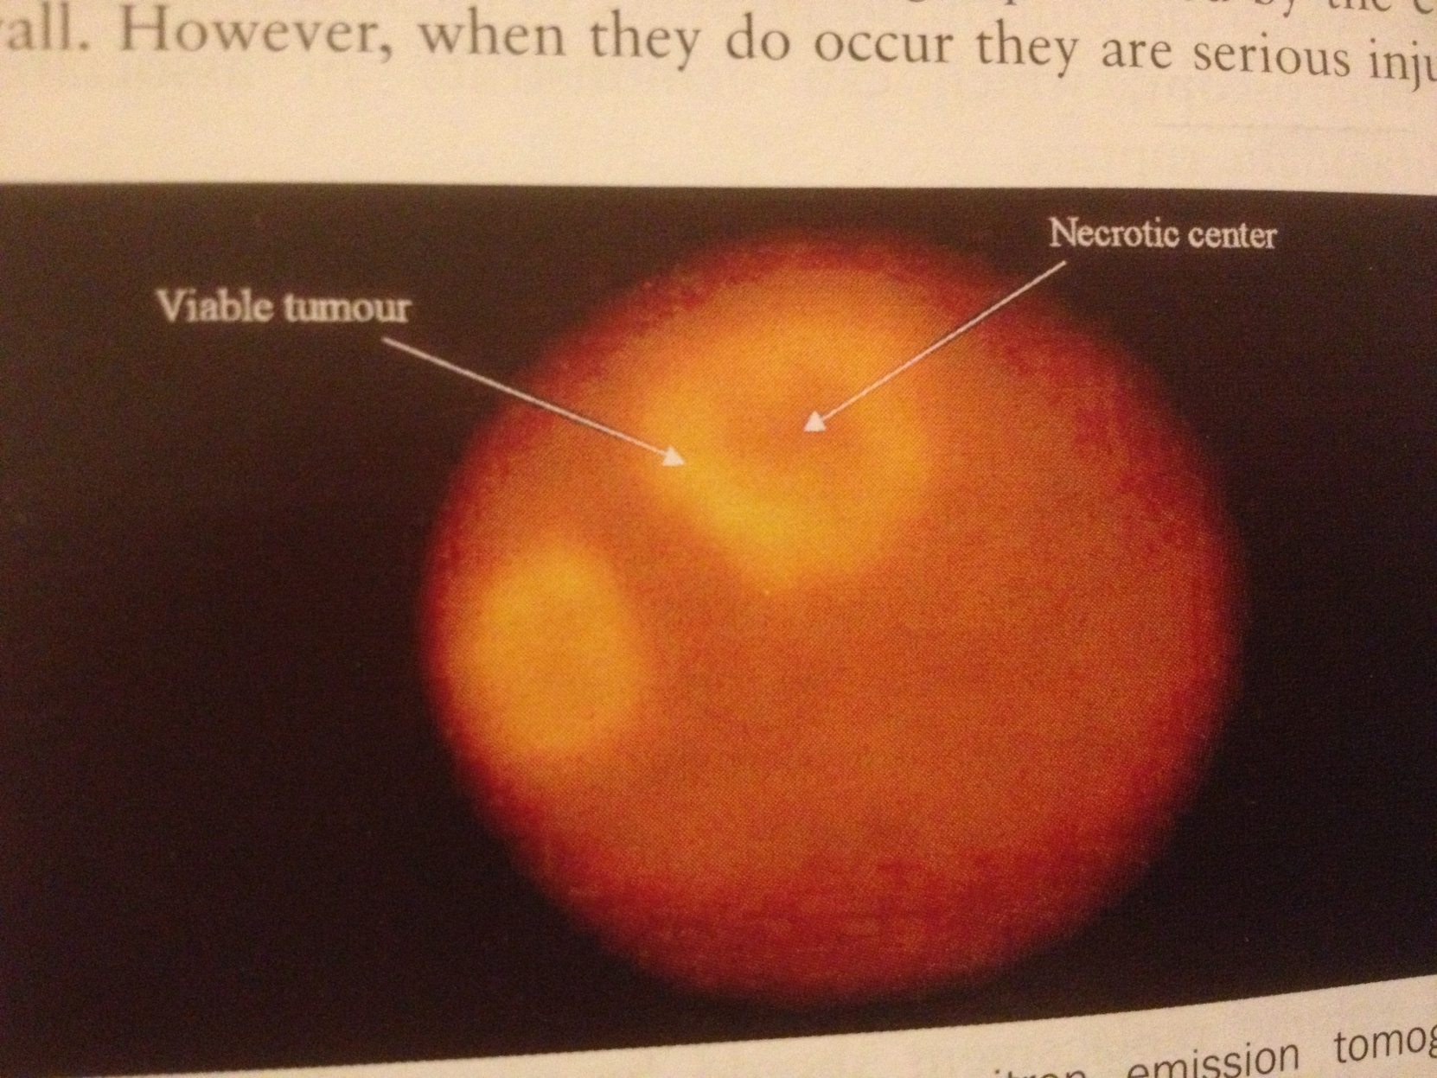
PET

Slide 27
Liver trauma:-
-may be blunt or penetration type.
-diagnosis depend on clinical suspicion.
1-all lower chest and upper abdominal stab
2-sever crush injuries of no 1 + # ribs, haemo-,
pneumothorax
3- penetrating wounds
4-patient with blunt trauma an haemo-dynamically stable
but has objective sings as upper abdominal tenderness&
gardening
5-peritoneal lavage bloody
6-by laparascopy

Slide 28
Initial management of liver injury:-
1- Penetrating
.resuscitation, ABC principles of ATLS.
.two large bore cannula
.cross matching of blood ( FFP, cryoprecipitate )
.full blood count
.LFT, electrolytes, urea , glucose, amylase, clotting screen measurement
.arterial gas analysis
.chest tube if indicated
.transfer the patient to theater

Slide 29
2-Blunt trauma:-
-same as penetrating wounds
-if stable do imaging for nature of the injury
-some cases can be treated conservatively but penetrating needs always operation
-indication to do operation in blunt trauma
1-ongoing bleeding
2-coagulopathy
3-generalized peritonitis

Slide 30
Surgical approach:-
-rooftop incision
-Pringle maneuver
-AB
-treatment further depend on the type of the injury
-damage control surgery by packing in sever injuries

Slide 31
Complications of liver injuries:-
1-sudden massive blood lose
2-delay He
3-subcapsular & intrahepatic haematoma
4-liver abscess duo to liver ischemia or seroma & haematoma infection
5-biliary fistula causing peritonitis
6-haemobilia causing upper rt. Quaderant pain, upper GIT bleeding, jaundice
7-hepatic artery aneurysm
8-arteriovenouse fistula
9-arteriobiliary fistula
10-portovenouse hypertention if aneurysm ruptured to portal vein
11-biliovenouse fistula causing jaundice
12-bronchiobiliary or pleurobiliary fistula
13-liver failure in extensive liver trauma

Slide 32
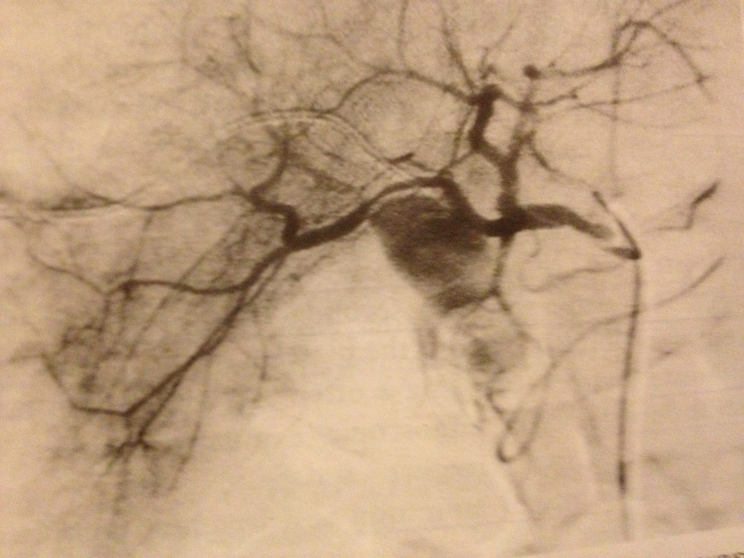
HEPATIC ART. ANURYSUM

Slide 33
Long term outcome of liver trauma
1-liver parenchyma regeneration occur
2-biliary tract stricture may be
. segmental or lobular needs conservative treatment
.or dominant extra-hepatic bile duct stricture causing obstructive jaundice treated by endo-biliary ballooning or stenting or Roux-en-Y hepatodochojejunostomy

Slide 34
Liver cysts
May be :-
1-primary congenital
.5-14%
.as simple cysts or polycystic liver disease
.common in females
2-secondary duo to :-
.trauma
.infections( pyogenic or paracytic)
.neoplastic

Slide 35
1-simple cystic lesions
-common incidental sonographic finding
-asymptomatic
-needs no treatment
-large one if causing abdominal discomfort do aspiration, if reoccur do deroofing laparascopic or open laparatomy

Slide 36
2-polycystic liver disease
-congenital one associated with other organs as pancrease,kidneys
-asymptomatic and incidentaly sonographic finding
-no effect , no treatment
-If multiple cyst causing discomfort give simple pain killer ,if not responding or causing sever pain which is duom to He to the cyst do laparascopic or open fenestration of the cyst.

Slide 37
3-Hydatid liver disease
-common in Mediterranean countries
-common in liver (70%), long,brain, bones ….
-Echinococcus granulosum
-Humanbeing is its interm. Host.
ingestion of ova pass to intestine ,portal vein ,liver (larval or cystic stage)
-

Slide 38
Clinical features:-
-silent seen by autopsy or incidentally by sonography
-abdominal discomfort or distension, dull pain at RT. UQ
-acute abdomen by trivial trauma duo to rapture of the cyst to peritoneal cavity and causing anaphylactic shock
-may cause abscess.
-if ruptured to :-
.billiary duct ..jaundice
.long via diaphragm…empyema
.stomach

Slide 39
Diagnosis:-
1-serology
.By ELISA( enzyme linked immunosorbent assay) in 85% positive
.negative if :-
1-no scoliosis in the cyst
2-no leaked
3-not viable parasyte
.eosinophilia > 7% positive

Slide 40
2-Plain abdomen x-ray
3-sonography
multilocular cyst
4-CT Abdomen
floating memmbrane
raptured cyst in peritoneal cavity

Slide 41
Treatment:-
1-albendazol/mebendazol
If failed
2-operation
3-calcified cyst only follow up
4- obstructive jaundice do ERCP then operation

