Slide 1
INTERSTITIAL AND INFILTRATIVE PULMONARY DISEASES
( DIFFUSE PARENCHYMAL LUNG DISEASE )
(Restrictive pulmonary Diseases)

Slide 2
INTRODUCTION
Restrictive lung diseases:
Intrinsic lung diseases: alteration in lung parenchyma
Extrinsic lung diseases: diseases of pleura, chest wall, or neuromuscular apparatus.

Slide 3
Restrictive Pulmonary Disease
Indicate limitation to full expantion of the lungs because of diseases in the lung paranchyma , chest wall or diaphragm.
( Lung volumes are decrease but flow rates are normal ).
As Interstitial lung disease( cryptogenic fibsosing alveolitis , sarcoidosis, asbestosis, silicosis , coal worker pneumoconiosis…)
TLC ( total lung capacity ) decrease
RV ( residual volume ) decrease
FEV1 / VC = or more than 70%

Slide 5
Overview of interstitial lung diseases
The interstitial lung diseases (diffuse parenchymal lung diseases DPLDs) are a heterogeneous group of conditions caused by diffuse thickening
of the alveolar walls with
inflammatory cells and exudates (e.g. the acute respiratory distress syndrome-ARDS), granulomas (e.g. sarcoidosis), alveolar haemorrhage (e.g. Goodpasture's syndrome), and/or fibrosis (e.g. fibrosing alveolitis).
Lungs start to scar and the interstitium(tissue between the air sacs) and lungs become stiff .

Slide 6
Interstitial lung diseases
The interstitial lung diseases (diffuse parenchymal lung diseases DPLDs) are a heterogeneous group of conditions caused by several different pathological processes , having similar symptomes , signs , radiological changes & pulmonary function tests.
The pathological changes are :
1- Thickening of alveolar wall by oedema, cellular exudates or fibrosis.
2- Increased stiffness of the lungs( reduced compliance).causing exertional dyspnoea.
3- Maldistribution of ventilation & perfusion, & gas transfer defect.causing hypoxemia particularly on exertion.

Slide 7
causes of interstitial lung diseases
1- Collagen vascular diseases
Scleroderma
Polymyositis/dermatomyositis
Systemic lupus erythematosus
Rheumatoid arthritis
Ankylosing spondylitis.

Slide 8
2- Drugs induced
Nitrofurantoin
Amiodarone
Gold
Bleomycin
Cyclophosphamide
Methotrexate
Radiation.

Slide 9
3- Primary or unclassified diseases
Sarcoidosis
Pulmonary histiocytosis X
Lymphangioleiomyomatosis (LAM)
Pulmonary vasculitis
Alveolar proteinosis
Eosinophilic pneumonia
Bronchiolitis obliterans organizing pneumonia (BOOP)

Slide 10
4- Idiopathic fibrotic disorders
Acute interstitial pneumonia
Idiopathic pulmonary fibrosis (usual intersttial pneumonitis)
Lymphocytic interstitial pneumonitis
Desquamative interstitial pneumonitis
Non-specific interstitial pneumonitis

Slide 11
5- Inhaled inorganic dust
Silica: silicosis
Asbestos: asbestosis
Beryllium: berylliosis
Cobalt: hard metal fibrosis
Coal workers pneumoconiosis
6- Inhaled organic dust
Hypersensitivity pneumonitis: farmer’s lung Bird fanciers lung….

Slide 12
7- Others
-As part of systemic inflammatory diseases e.g.ARDS.
-Chronic pulmonary oedema e.g. secondary to mitral srenosis.

Slide 13
Diagnosis of INTERSTITIAL LUNG DISEASES
Diagnosis often presents a considerable clinical challenge , necessitating meticulous attention to the history and physical signs and a cooperative approach from teams of clinicians, radiologists and pathologists.( investigations )

Slide 14
History
The duration of disease may sometimes be difficult to ascertain.
Gradually progressive shortness of breath on exertion may be the only symptom, and hence the patient may not present clinically until there is extensive lung pathology.
History-taking should include a thorough and comprehensive search for exposure to organic and inorganic dusts.
A 'lifetime' occupational history is essential and should include hobbies that may involve similar exposures.

Slide 15
Contact with birds at home or in the working environment is the cause of the most common form of hypersensitivity pneumonitis (HP).
The smoking status should be recorded and a drug history should be obtained.
A history of rashes, joint pains or renal disease may suggest an underlying connective tissue disorder or vasculitis
. The presence of any comorbid disease should be ascertained such as collagen vascular disease, immunodeficiency, HIV or malignancy.
In exceptional cases there is a family history of DPLD.

Slide 16
Clinical features of interstitial lung diseases
Gradually progressive SOB on exertion & exercise limitation.
Dry non productive cough.
Digital clubbing (as in fibrosing alveolitis & asbestosis).
Restriction of chest expantion.
Auscultation: end inspiratory crepitations particularly over the lower zones posteriorly & laterally.
In advanced cases:. tachypnoea , cyanosis , signs of pulmanary hypertention & Rt. Heart failure
Extrapulmonary signs, including lymphadenopathy or uveitis, may be present in sarcoidosis
arthropathies or rashes may occur when a DPLD is a manifestation of a connective tissue disorder .

Slide 17
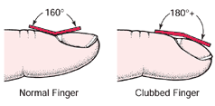
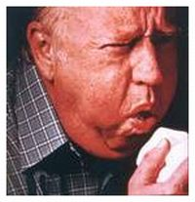
Signs and Symptoms
Breathlessness
Dry cough
Fingertips enlarge and nails curve over tops of fingertips

Slide 18
Investigations in interstitial lung diseases
Laboratory investigations
. Full blood count-lymphopenia in sarcoid; eosinophilia in pulmonary eosinophilias and drug reactions; neutrophilia in hypersensitivity pneumonitis
Ca²⁺-may be elevated in sarcoid
Lactate dehydrogenase (LDH)-may provide non-specific indicator of disease activity .
Serum ACE-non-specific indicator of disease activity in sarcoid
ESR and CRP may be non-specifically raised
Autoimmune screen and rheumatoid factor may suggest collagen vascular disease
Radiology
. Chest X-ray
High-resolution CT scan
Gallium scanning

Slide 19
Chest X-ray typically shows a fine reticular, reticulonodular or even nodular pattern of infiltration at the bases and periphery with cystic areas and honeycombing in advanced disease.
However, plain radiography is insensitive and may not appear abnormal until disease is advanced.
HRCT is more sensitive and specific and has become extremely valuable in detecting early interstitial lung disease, assessing the extent and type of involvement and guiding further investigations and management

Slide 20
Pulmonary function
Spirometry, lung volumes, gas transfer.
Bronchoscopy
Bronchoalveolar lavage, differential cell counts
Bronchial biopsy may be useful in sarcoid .
Lung biopsy (in selected cases)
Transbronchial biopsy useful in sarcoid and differential of malignancy or infection
Video-assisted thoracoscopy (VATS)
Others
Liver biopsy
Urinary calcium excretion may be useful in sarcoid

Slide 21
Pneumoconiosis
Lung disease caused by mineral dust exposure:
Asbestosis
Coal workers lung
Silicosis

Slide 22
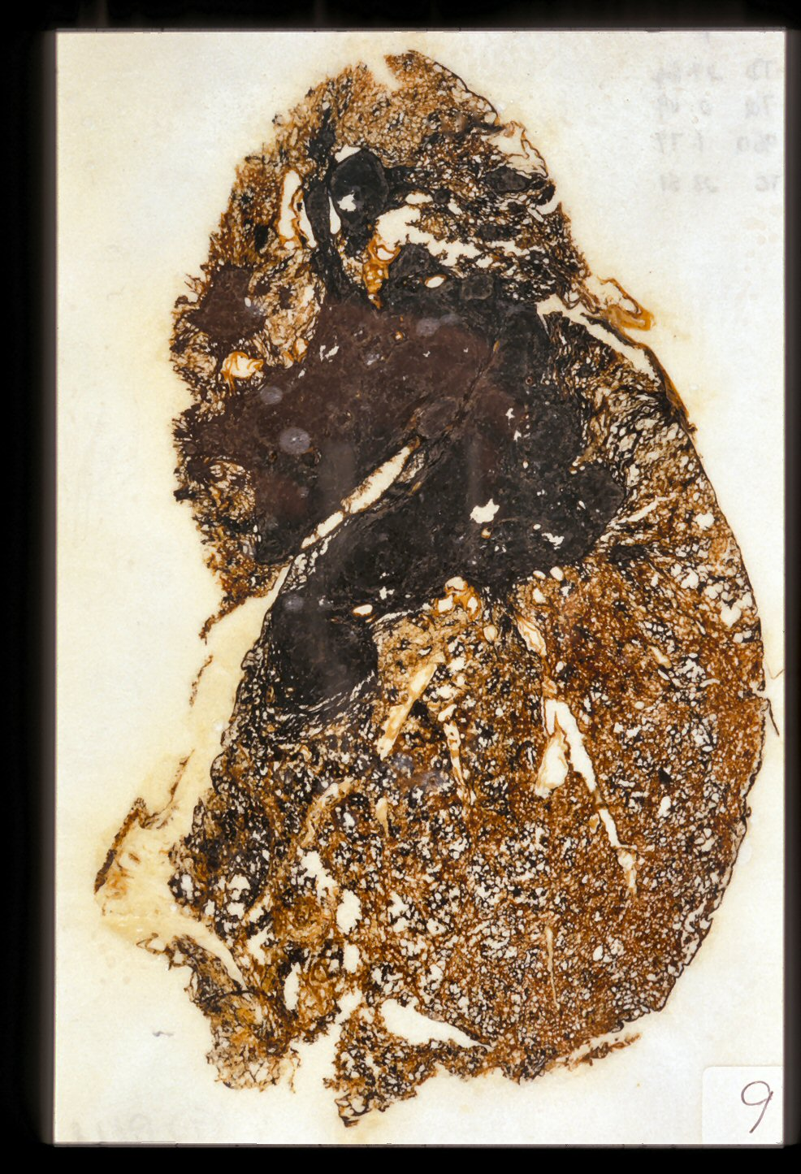
Coal miner with progressive massive fibrosis (unstained)

Slide 23
IDIOPATHIC INTERSTITIAL PNEUMONIAS
The idiopathic interstitial pneumonias (IIPs) are characterised by varying patterns of inflammation and fibrosis in the lung parenchyma.
Idiopathic interstitial pneumonias include the following diseases:
-Idiopathic pulmonary fibrosis (IPF). (The most important disease )
- desquamative interstitial pneumonia (DIP),
- acute interstitial pneumonia (AIP),
- non-specific interstitial pneumonia (NSIP),
-respiratory bronchiolitis-interstitial lung disease (RB-ILD)
-cryptogenic organising pneumonia (COP)
-lymphocytic interstitial pneumonia (LIP)

Slide 24
IDIOPATHIC PULMONARY FIBROSIS (IPF)
This term has replaced cryptogenic fibrosing alveolitis and refers to a specific form of DPLD characterised by pathological (or radiological) evidence of usual interstitial pneumonia (UIP).
( IPF,CFA, UIP)

Slide 25
Aetiology of IPF
The aetiology remains unknown
speculation has included exposure to infectious agents such as Epstein-Barr virus, occupational dusts such as metal or wood dusts, prior use of antidepressants, and a possible role for chronic gastro-oesophageal reflux.
Familial cases are rare but genetic factors that control the inflammatory and fibrotic response are likely to be important.
The disease displays a strong association with cigarette smoking

Slide 26
IPF(CFA )has an incidence of 6 – 10 per 100 000 per year & is about twice as common among cigarette smokers as in non-smokers.
Men are more commonly affected than women.
Macroscopically , the lungs show subpleural fibrosis & a honeycomb appearance , predominantly in the lower lobes & basolateral pleural regions.
Microscopically , there are fibroproliferative lesions representing the site of healing alveolar injury.
there is a variable mononuclear cell infiltration of the alveolar walls , fibrosis & smooth muscle proliferation.

Slide 27
Idiopathic interstitial pneumonias

Slide 28
Clinical features of IPF
CFA is a disease of the elderly , with a mean age at presentation of 69 years.
Progressive exertional breathlessness is usually the presenting symptom, often accompanied by dry cough.
Digital clubbing is observed in 60 % of cases.
Chest expantionis poor.
On chest auscultation : bilateral end – inspiratory crepitations ,particularly over the lower zones posteriorly.

Slide 29
Investigations of IPF
1- Blood tests
are of little value.
Rheumatoid factor and antinuclear factor can be detected in 30-50% of patients.
The erythrocyte sedimentation rate (ESR) and lactate dehydrogenase (LDH) are elevated in most cases.

Slide 30
2- Radiological investigations:
CXR
diffuse pulmonary opacities more obvious in the lower zones & peripherally.( lower zone bi-basal reticular and reticulonodular opacities).
The hemidiaphragms are high & the lungs appear small.
In advanced cases CXR may shows a 'honeycomb' appearance ( in which diffuse pulmonary shadowing is interspersed with small cystic translucencies) but it is non-specific
.
HRCT
may be diagnostic, demonstrating a patchy, predominantly peripheral, subpleural and basal reticular pattern with subpleural cysts (honeycombing) and/or traction bronchiectasis and is particularly useful in early disease when chest X-ray changes may be indistinct.

Slide 31
Chest X-ray of IPF

Slide 32
HRCT of IPF

Slide 33
CT SCAN

Slide 34
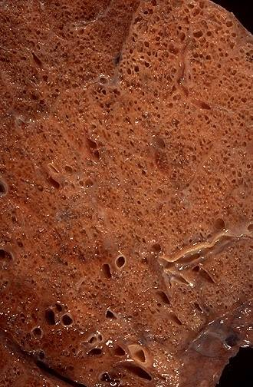
Honeycomb lung
Subpleural “enlarged” spaces with fibrous walls

Slide 35
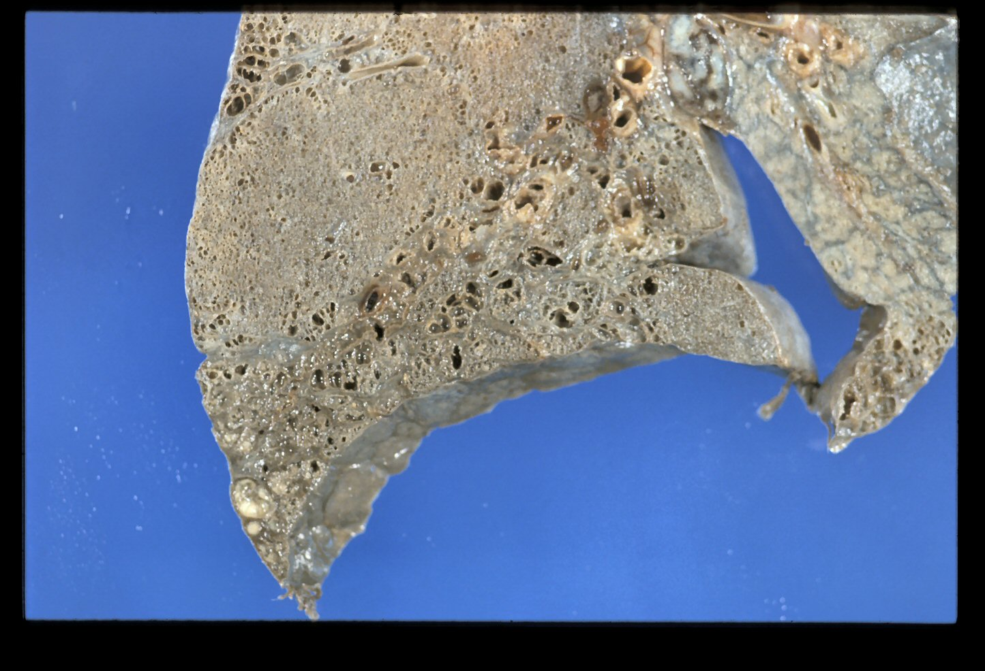
Honeycombing – basal/subpleural

Slide 36
3- Pulmonary function tests:
show a restrictive defect with reduced lung volumes and gas transfer.
TLC ( total lung capacity ) decrease
RV ( residual volume ) decrease
FEV1 / VC = or more than 70%
gas transfer factor decrease.
(However, lung volumes may be preserved in patients with concomitant emphysema).

Slide 37
4- Arterial blood gases:
- In early stages : arterial hypoxaemia on exertion.
- In later stages : arterial hypoxaemia & hypocapnia at rest.

Slide 38
5- Lung biopsy:
A firm diagnosis of (CFA IPF, UIP) can usually be achieved on the bases of the history , clinical finding & HRCT , But if doubt exist an open lung biopsy is indicated.
(Patients with typical clinical features and HRCT appearances consistent with UIP do not require lung biopsy, particularly if other known causes of interstitial lung disease have been excluded).
6- Bronchoalveolar lavage : may shows an increased number of neutrophils.
Transbronchial biopsy & Bronchoalveolar lavage may be used to exclude alternative diagnoses

Slide 39
Management of IPF

Slide 40
1- Immunosupressive therapy:
Corticosteroid :the response to steroid is usually poor, but a proportion of patients do respond in terms of symptoms(50%) & lung function(25%).
Indications for using corticosteroid:
a- Highly symptomatic patient.
b- Rapidly progressive disease.
c- Patient who have a predominantely ground glass appearance on HRCT.
d- Fall of more than 15% in FVC (Forced Vital Capacity ) or gas transfer over 3 – 6 month period.
The initial treatment is combined therapy with Prednisolone (0.5 mg/kg) combined with azathioprine (2-3 mg/kg).
Assessment of response to this treatment is by repeated measurment of lung volumes , gas transfer facror & CXR.
Immunosuppressive therapy should be withdrown over a few weeks if there is no response.
If there is objective evidence of improvement , the prednisolone dose can be reduced gradually to a maintenance dose of 10 – 12.5 mg / day.

Slide 41
2-Lung transplantation :
should be considered in young patients with advanced disease.
3- Others:
Cyclophosphamide occasionally used.
Antifibrotics such as colchicine may be used.
Oxygen, rehabilitation, psychosocial aspects are helpful

Slide 42
Prognosis of IPF
CFA has a high mortality rate . The 5 year survival rate is less than 30 %
The median survival time of patients with CFA is about 3.5 years
Most deaths occur in patients over the age of 55 years with male predominating.
In the majority of patients the disease is progressive , even in those who have responded to treatment.
High numbers of fibroblastic foci on biopsy have been associated with a poor outcome.

